Slide 1
Two Major Techniques: Butterworth and Chebychev
Butterworth:
Specify from passband, determine N from stopband:

Slide 2
Poles of Butterworth Filter:
which yields the poles as solutions
N=2
and choose the N poles in the stable region.
+
+
poles
+
+
s-plane

Slide 3
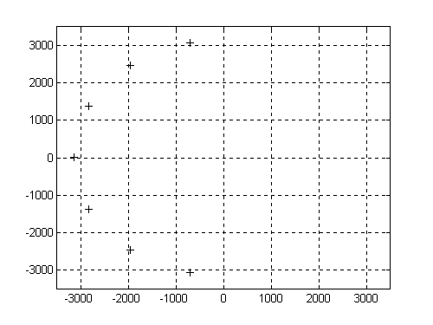
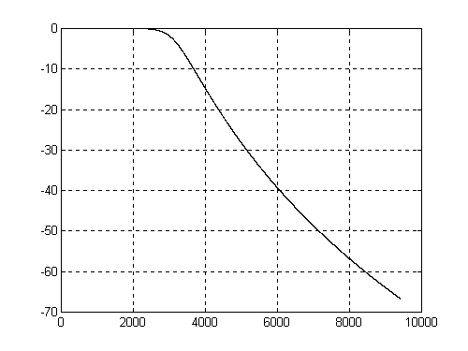
Example: design a low pass filter, Butterworth, with 3dB bandwith of 500Hz and 40dB attenuation at 1000Hz.
Solution:
solve for N from the expression
poles at

Slide 4
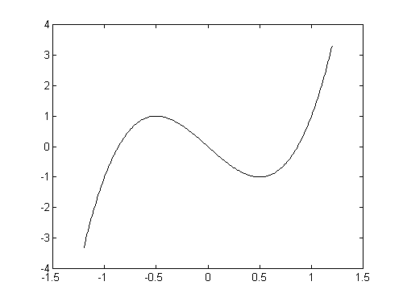
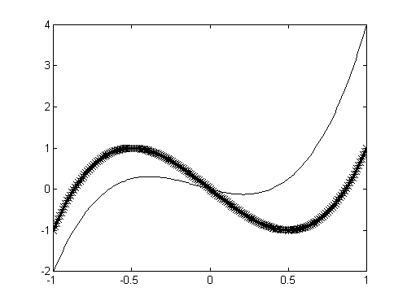
Chebychev Filters.
Based on Chebychev Polynomials:
Property of Chenychev Polynomials:
within the interval Chebychev polynomials have least maximum deviation from 0 compared to polynomials of the same degree and same highest order coefficient

Slide 5
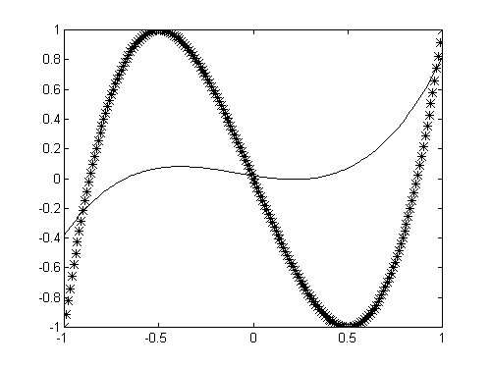
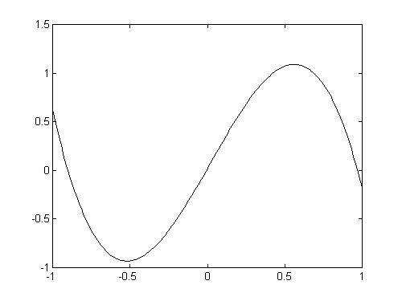
Why? Suppose there exists with smaller deviation then
root
root
root
But: has degree 2 …
… and it cannot have three roots!!!
So: you cannot find a P(x) which does better (in terms of deviation from 0) then the Chebychev polynomial.

Slide 6
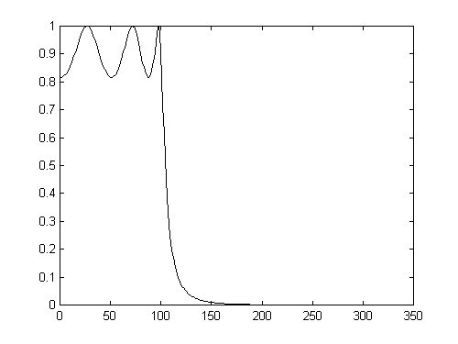
Chebychev Filter:
Since (easy to show from the definition), then

Slide 7
Design of Chebychev Filters:
Formulas are tedious to derive. Just give the results:
Given: the passband, and
which determines the ripple in the passband,
compute the poles from the formulae
s-plane

Slide 8
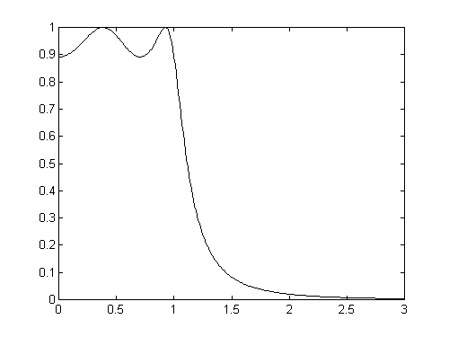
Example: design a Chebychev low pass filter with the following specs:
passband with a 1dB ripple,
stopband with attenuation of at least 40dB.
Step 1: determine . The passband frequency
For 1dB ripple,
Step 2: determine the order N. Use the formula
with , to obtain

